Slide 1

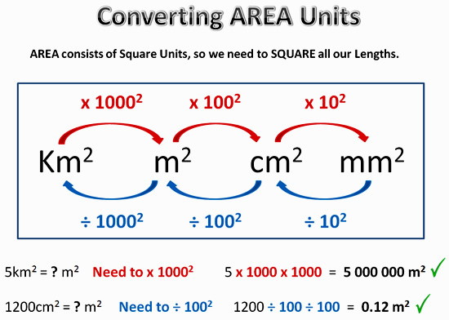
My Measurement Interactive Notebook
Name
Class
Teacher Mr Evans
Term 1 Semester 1
1

Slide 2
Contents
Glossary or Formula Page
Page
Date
Description
2
3

Slide 3
Tasks
24
7
30
Essential Question
Questions
Notes
Summary
6
7

Slide 4
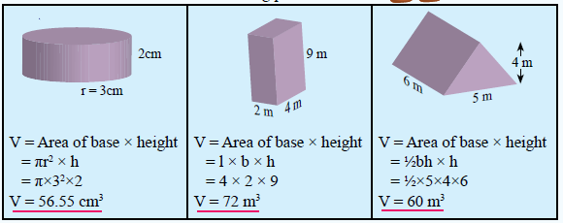
24
7
30
Date
Topic : Volume
EQ – How do you find the volume of a prism?
To find the volume of a prism, find the area of the base and
Multiply it by the height or length of the prism
Area of the base
Height/length of the prism
Cylinder Rectangular Prism Triangular Prism

Slide 6
Volume of Cuboids
A cuboid is a 3-dimensional object made up of a rectangles and squares
Volume = height x width x depth
Units: cm³, m³, mm³, km³, etc
height
depth
width

Slide 7
Volume of Cuboids
Volume = width x height x depth
V = 4 x 3 x 12
V = 144cm³
12cm
3cm
4cm
6m
7mm
11m
7mm
5cm
80cm³
396m³
343mm³
2cm
8cm
6m
7mm

Slide 8
I Do
5cm
2cm
8cm

Slide 9
We Do
6m
11m
6m

Slide 10
You Do

Slide 11
Questions

Slide 12
Notes Review
24, 7 ,30
Date
Title
Essential question
Notes complete
Notes complete with colour and diagrams
Questions completed
Contents page filled in
Formula page filled in

Slide 13
Homework
Review your notes and write a summary answering the essential question.

